Slide 1
Self-Evolving Multimodal
Federated Agents
for Continual Learning under Dynamic Distribution Shifts
Major Project Proposal Presentation
A practical framework combining multimodal learning, federated learning, adaptive agents and continual memory
1

Slide 2
1. Project Overview
Multimodal
Federated Learning
Self-Evolving
Learns from multiple input types, such as movie poster images and plot text.
Multiple clients train locally and share model updates rather than raw data.
Detects changes, adapts the model and retains useful knowledge over time.
Core idea: move from “train once → deploy” toward “learn → detect change → adapt → remember”.
Demonstration use case: multimodal movie genre prediction using poster images + plot text.
Federated clients can be simulated on one computer for a practical college prototype.
2

Slide 3
2. Problem Statement
Conventional ML models are usually trained once and then deployed.
Accuracy can fall when new data differs from the training distribution—e.g., changes in image quality, style, source or noise.
Multimodal systems may require centralized data, creating data-sharing and privacy concerns.
Continual learning can cause catastrophic forgetting when new knowledge is introduced.
A practical framework is needed to combine multimodal learning, federated collaboration, distribution-shift detection and continual adaptation.
3

Slide 4
3. Research Gaps
Static training
Deployment data may not remain similar to training data.
Siloed learning
Federated learning helps privacy, but multimodal and changing data add complexity.
Limited adaptation
Models may degrade without a controlled mechanism to decide when to adapt.
Forgetting
Continual learning needs memory/replay or regularization to retain earlier knowledge.
Integrated framework
A practical combination of multimodal fusion, federated learning, shift detection, agent-based adaptation and continual memory is still challenging.
4

Slide 5
4. Previous Studies / Research Background
FedAvg — McMahan et al. (2017)
Federated averaging for aggregating locally trained model updates.
FedProx — Li et al. (2020)
Improved federated optimization under heterogeneous client conditions.
MM-IMDb — Arevalo et al. (2017)
Multimodal movie genre classification using poster images and plot text.
EWC — Kirkpatrick et al. (2017)
A continual-learning method for reducing catastrophic forgetting.
Tent — Wang et al. (2021)
Demonstrated test-time adaptation to distribution shifts.
5

Slide 6
5. Proposed Problem Solution
1
Multimodal model
Extract image/text features and fuse them for prediction.
2
Federated clients
Train locally on separate data partitions and share model updates.
3
Shift detector
Monitor confidence/features/statistics to identify changed input conditions.
4
Adaptive agent
Choose normal inference or trigger local adaptation when a meaningful shift is detected.
5
Continual memory
Store useful representations/examples and use replay or regularization to reduce forgetting.
6
Global improvement
Aggregate client updates and redistribute the improved global model.
6

Slide 7
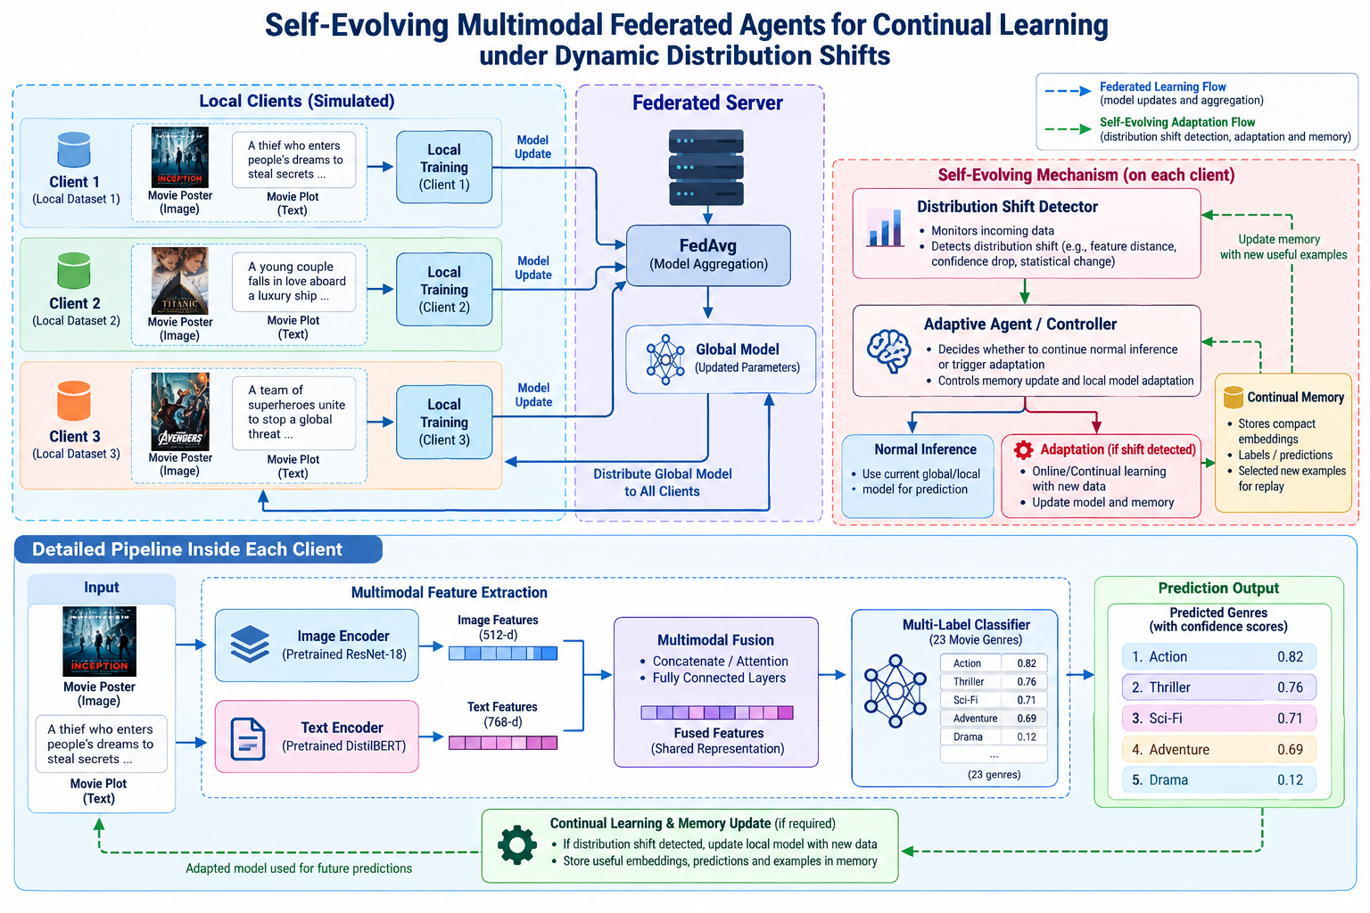
6. System Architecture
7

Slide 8
7. Research Analysis & Experimental Methodology
Baseline
Federated
Distribution Shift
Train a centralized multimodal model and measure accuracy/F1 on standard test data.
Split data among simulated clients and compare FedAvg with the centralized baseline.
Use controlled blur, noise, brightness and style changes to evaluate robustness.
Continual Learning
Agent Adaptation
Metrics
Introduce new data sequentially and measure retention/forgetting.
Compare shift-aware adaptation against a model with no adaptation.
Accuracy, macro/micro F1, loss, confidence, communication rounds and retention/forgetting.
8

Slide 9
8. Dataset — MM-IMDb
MM-IMDb is a multimodal movie dataset containing poster images and plot text.
It contains approximately 25,959 movies with multi-label genre annotations.
Each sample provides complementary visual and semantic information.
Preprocessing: image resizing/normalization, text cleaning/tokenization, train/validation/test split and client-wise partitioning.
Controlled shifted versions can be created using blur, noise, brightness and style changes.
The dataset is suitable for demonstrating multimodal learning, federated partitions and dynamic distribution shifts.
9

Slide 10
9. Technologies & Tools
Programming
Continual Memory
Python
FAISS / replay buffer
Deep Learning
Data Processing
PyTorch
NumPy, Pandas, OpenCV
NLP
Interface
Hugging Face Transformers / DistilBERT
Streamlit
Computer Vision
Visualization
Torchvision / ResNet-18
Matplotlib / Plotly
Federated Learning
Development
Flower
Jupyter / VS Code, Git/GitHub
10

Slide 11
10. Expected Outcomes
Working multimodal classifier using image + text information.
Functional federated-learning simulation with multiple clients and global aggregation.
Distribution-shift detection that identifies changed input conditions.
Adaptive agent that selects normal inference or triggers model adaptation.
Continual memory/replay component that helps retain useful prior knowledge.
Experimental comparison of centralized, federated, non-adaptive and adaptive approaches.
A simple Streamlit dashboard for demonstration and evaluation.
11

Slide 12
11. Scope & Practical Limitations
Scope
Limitations / Assumptions
• Research prototype for continual multimodal learning
• Simulated federated clients
• Controlled distribution shifts
• Agent-based adaptation and memory
• Quantitative evaluation
• Federated clients are simulated rather than deployed across real organizations
• Adaptation is kept computationally practical
• The project demonstrates the concept rather than production-grade privacy/security
• Results depend on dataset and shift scenarios
Priority: a reproducible, explainable prototype rather than training a very large foundation model.
12

Slide 13
12. Conclusion
The proposed system aims to move from “train once → deploy” toward “learn → detect change → adapt → remember”.
Multimodal learning provides richer information.
Federated learning enables collaborative training without centralizing raw client data.
Distribution-shift detection identifies when the deployment environment changes.
An adaptive agent controls when learning should occur.
Continual memory helps preserve useful previous knowledge.
13

Slide 14
13. Key References
McMahan, B. et al. (2017). Communication-Efficient Learning of Deep Networks from Decentralized Data. AISTATS.
Li, T. et al. (2020). Federated Optimization in Heterogeneous Networks. MLSys.
Arevalo, J. et al. (2017). Gated Multimodal Units for Information Fusion. ICLR Workshop.
Kirkpatrick, J. et al. (2017). Overcoming Catastrophic Forgetting in Neural Networks. PNAS.
Wang, D. et al. (2021). Tent: Fully Test-Time Adaptation by Entropy Minimization. ICLR.
MM-IMDb dataset: multimodal movie posters + plot text with multi-label genres.
14

